Slide 1
PERFORMING ADVERSARIAL ATTACK ON SOTA VIDEO CLASSIFICATION SYSTEM
GROUP - 02
RICHA THAKUR (D23151)
ASMITA ANKUSH KAMBLE (T23200)
ASHUTOSH SHARMA (B20087)

Slide 2
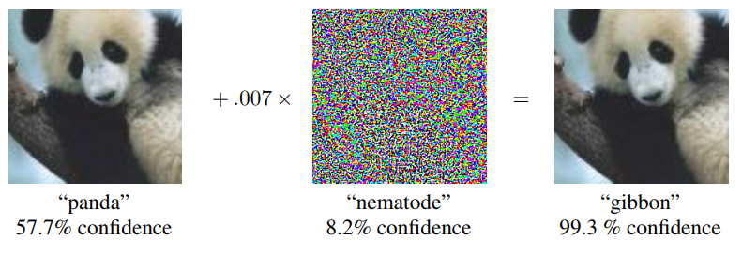
INTRODUCTION
Adversarial Attacks on Image Classification Models
Adversarial attacks are those malicious attacks on the data which may seem okay to the human eye but causes misclassification in a machine-learning pipeline.
An Adversarial Attack is a technique to find a perturbation that changes the prediction of a machine learning model.
Fig. 1: An Adversarial Example Generation [1]

Slide 3
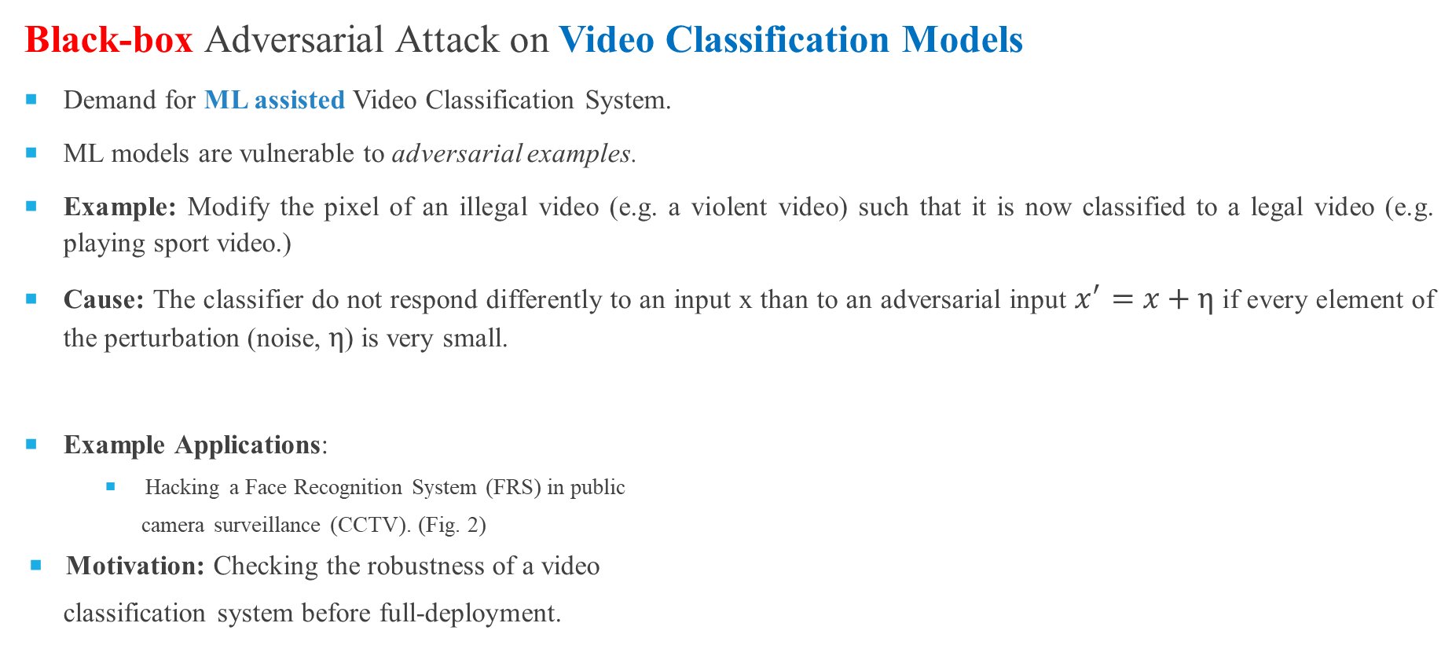

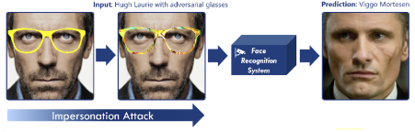
PROBLEM STATEMENT (MOTIVATION)
Fig. 2: Hacking a Face Recognition System [ ]

Slide 4
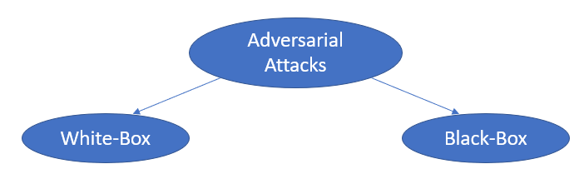
ADVERSARIAL ATTACKS
 | White-Box Attack | Black-Box Attack (more practical)
Adversary Knowledge | Detailed knowledge includes: Network architecture (No. of layers, types of layers) Input, output Training Data Weights, and hyperparameters | No knowledge, except: Querying the model on input, and observing the labels.
Table 1: Adversarial Attack Techniques

Slide 5
LITERATURE REVIEW
Technique | Research Paper | Dataset and Victim Model | Attack target | Published in
Adversarial Attacks | FGSM (Fast Gradient Sign Method) [7] | ImageNet, GoogLeNet (White-box) | Attack on gradients | 2015
 | BIM (Basic Iterative Method) [8] | ImageNet, TensorFlow Camera Flow App (Black-box) | Attack on input images | 2016
 | PGD (Projected Gradient Descent) [9] | CIFAR, DNN hosted by MetaMind, Amazon and Google (Black-box) | Attack on gradients | 2017
 | CW (Carlini and Wagner) [10] | MNIST, Custom CNN (White-box) | Attack on optimization algorithm | 2017
 | AdvGAN (Adversarial GANs) [11] | MNIST, GANs (White-box) | Attack on input images | 2018

Slide 6
LITERATURE REVIEW
Technique | Research Paper | Dataset | Defence Type | Published in
Adversarial Defence | AdvIT (Adversarial Frames Identifier) [13] | DAVIS2017 | Detection Defence | 2023
 | Comdefend [14] | ILSVRC12 | Reconstruction Defence | 2021
 | Randomized Smoothing (RS) [15] | CIFAR 10 | Certified Defence | 2023
 | CNN-generated Image Detector [16] | CelebDF | Detector for GAN generated image | 2022
 | Adversarial training [17] | CIFAR-10 | Improve accuracy of classifier | 2023

Slide 7
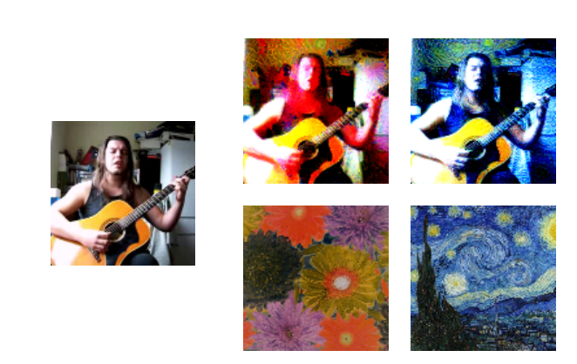
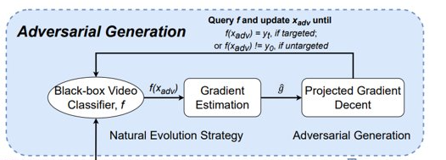

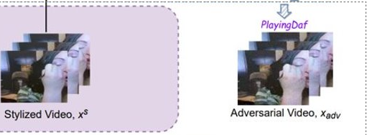

SOTA
StyleFool : A black box unrestricted adversarial attack framework against video classification system. [13]
Original
Noise added
(Stylized image)

Slide 8
REPLICATION OF SOTA
Overview:
Dataset | No. of classes | Total Videos | Classes
UCF-101 Action Recognition Dataset | 101 action classes (175 videos in each class) | 17,675 | 101 actions (125 videos in each class)
Dataset split | Target Video classifier | Accuracy | Attack performance evaluation
70% - Style set 30% - Adversarial sample generation | C3D | 84.9% | 100 randomly selected video
Notes:
101 classes -> 1 class = 1 actin -> 25 x 7 videos hain-> 7 different types, 1 type ki 7 videos hain
C3D learns both spatial and temporal features of input videos using 3D convolution.
C3D requires videos with 16 frames as input, we separate all videos into 16-frame snippets.

Slide 9
REPLICATION OF SOTA (RESULTS)
Untargeted (UCF-101) | ASR | minQ | maxQ | AvgQ
 | 100 | 1 | 19,031 | 3,811
Targeted (UCF-101) | ASR | minQ | maxQ | AvgQ
 | 100 | 1284 | 248,131 | 65,066
Time cost | Preparation/ image (sec) | Attack time cost (min)
 | 0.4174 | 10 - targeted 2 - untargeted
Hardware
RTX3070i
Notes:
101 classes -> 1 class = 1 actin -> 25 x 7 videos hain-> 7 different types, 1 type ki 7 videos hain

Slide 10
LIMITATION OF SOTA - STYLEFOOL
The processes of generating styles, calculating color themes and calculating target class confidence are needed before performing Adversarial attack, which are computationally expensive.
O(class x N x Dim)
Unrestricted perturbation is not always imperceptible to human eyes.

Slide 11
OVERCOMING LIMITATIONS - A NOVEL SOLUTION
Input: Black-box classifier f, input video x₀, input label y₀, target class y_{t}, perturbation threshold ε_{adv}, initial perturbation ε, total loss L_{total}, adversarial loss L, structured noise Ɲ.
Output: Adversarial video x_{adv}.
x_{s} ← (x₀, Ɲ), Generate a sample video by adding a structured noise instead of style set.
if yt == None then,
x_{adv} ← x_{s}
x_{adv} ← PGD(x_{adv}, x_{s}, NES(x_{adv}, L), n, εadv) , while f(x_{adv}) == y₀
else,
x_{adv} ← x_{s}
x_{adv} ← BPGD(x_{adv}, x_{s}, NES(x_{adv}, L), n, ε_{adv}) , while f(x_{adv}) != y_{t} or ε > ε_{adv}

Slide 12
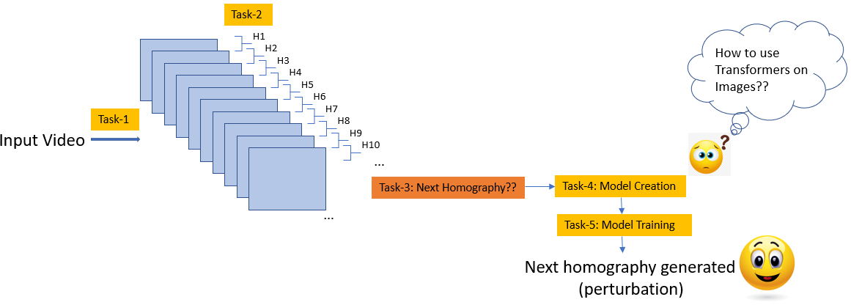
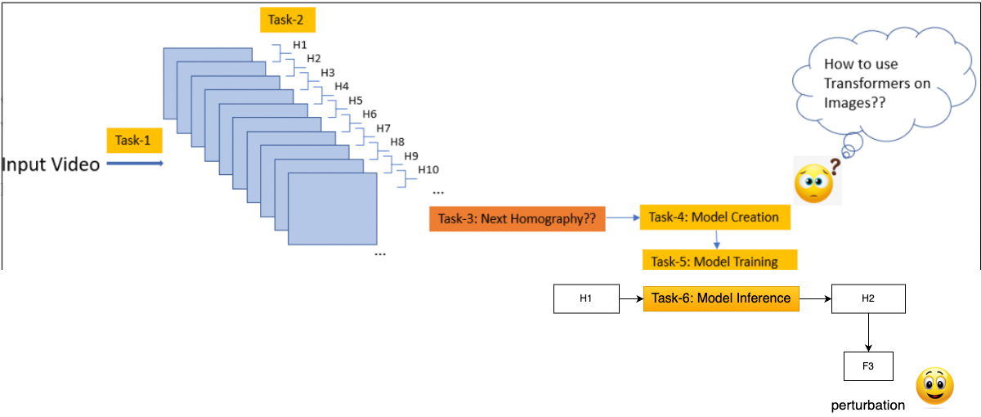
NOVEL IDEA TO IMPLEMENT (METHODOLOGY)
Objective 3: To perform an adversarial black-box attack on Videos using SOTA GPT-2 architecture (presently working on)
Methodology used:
Can we create a structured noise to perform an adversarial black-box attack on Videos classification system?
Fig. : Overview of the methodology being used to generate a structured noise

Slide 13
REFERENCES
[1] Zhang, Yifu, et al. "Bytetrack: Multi-object tracking by associating every detection box." European Conference on Computer Vision. Cham: Springer Nature Switzerland, 2022.
[2] Wang, Chien-Yao, Alexey Bochkovskiy, and Hong-Yuan Mark Liao. "YOLOv7: Trainable bag-of-freebies sets new state-of-the-art for real-time object detectors." Proceedings of the IEEE/CVF Conference on Computer Vision and Pattern Recognition. 2023.
[3] Deng, Jiankang, et al. "Retinaface: Single-stage dense face localisation in the wild." arXiv preprint arXiv:1905.00641 2019.
[4] Liang, Jingyun, et al. "SwinIR: Image restoration using swin transformer." Proceedings of the IEEE/CVF international conference on computer vision. 2021.
[5] Ledig, Christian, et al. "Photo-realistic single image super-resolution using a generative adversarial network." Proceedings of the IEEE conference on computer vision and pattern recognition. 2017.
[6] Deng, Jiankang, et al. "Arcface: Additive angular margin loss for deep face recognition." Proceedings of the IEEE/CVF conference on computer vision and pattern recognition. 2019.
[7] Goodfellow I. J., Shlens J., and Szegedy C. “Explaining and Harnessing Adversarial Examples”, ICLR, 2015.
[8] Kurakin A., Goodfellow I., and Bengio S. “Adversarial Examples in the Physical World”. ICLR 2017.
[9] N. Papernot, P. McDaniel, I. Goodfellow, S. Jha, Z.B. Celik, A. Swami, “Practical black-box attacks against machine learning”, in: Proceedings of the 2017 ACM on Asia conference on computer and communications security, 2017.
[10] Carlini N., Wagner D., “Towards evaluating the robustness of neural networks”, IEEE, 2017.
[11] Xiao, Chaowei, et al. "Generating adversarial examples with adversarial networks." arXiv preprint arXiv:1801.02610 (2018).
[12] Meden, Blaz et al. “Face deidentification with controllable Privacy protection”, Image and Vision Computing, 2023.
[13 ] Cao, Yuxin, et al. "Stylefool: Fooling video classification systems via style transfer." 2023 IEEE Symposium on Security and Privacy (SP). IEEE, 2023.

